Slide 1
Cellular Ecology of the Mouse Thymus
Mary Browning
3/17/2015

Slide 2
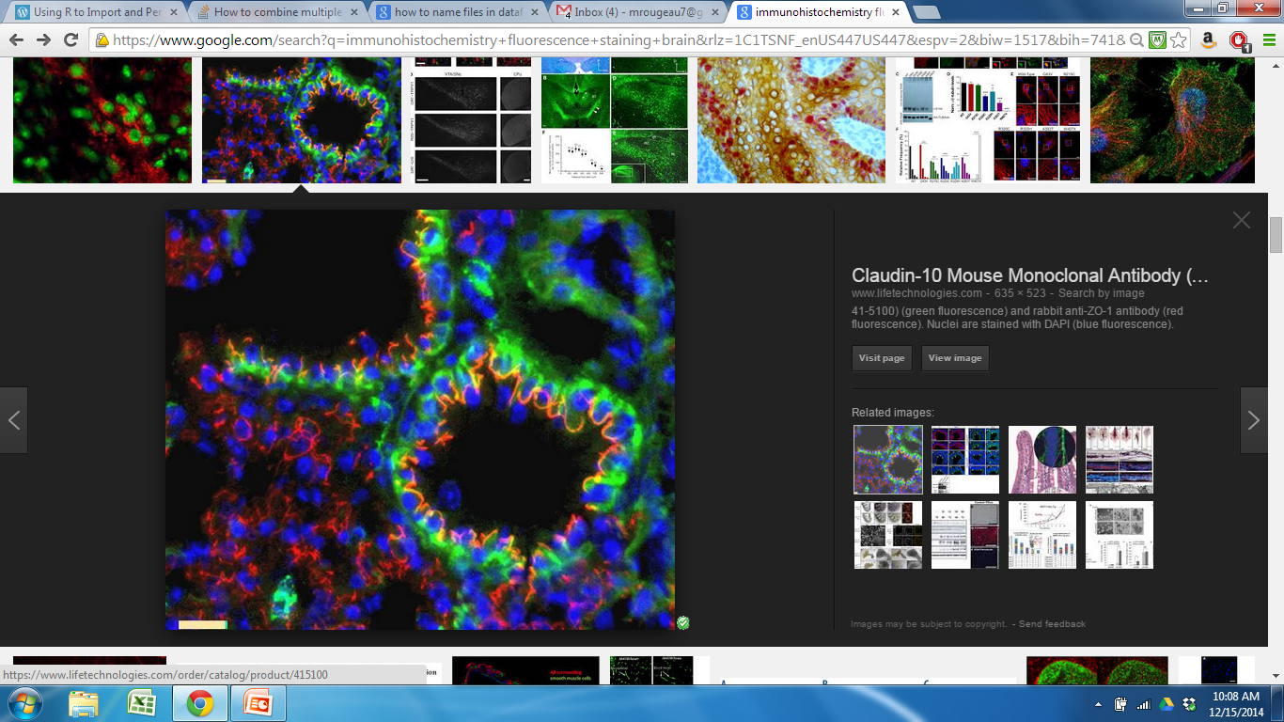
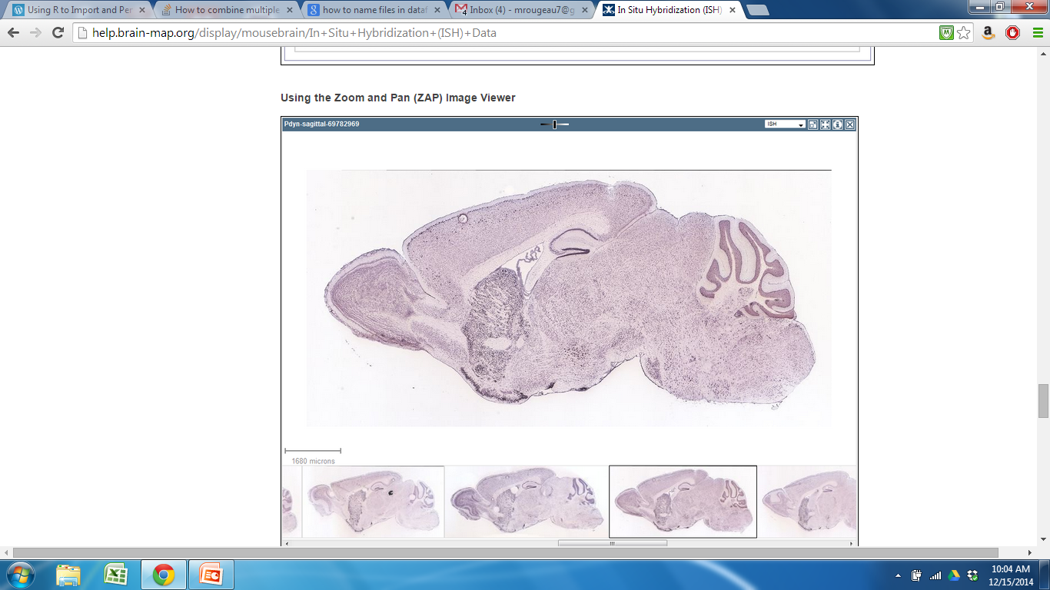
Organization of Organs
Notes:
My project was developed in order to create a method/way that would allow us to quantitatively look at organization of cell types within biological organs.
We have quantiative tools for composition, but for organization
beyond essentially descriptive assays (IHC and histological) available in the field of organ biology-biased, limited by what you can see
We are very limited by tools that are available for looking at cellular organization
Organization is impt for learning about function
GOAL: develop a quantitative method to look at organization
How do we do this?

Slide 3
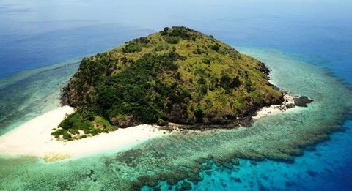
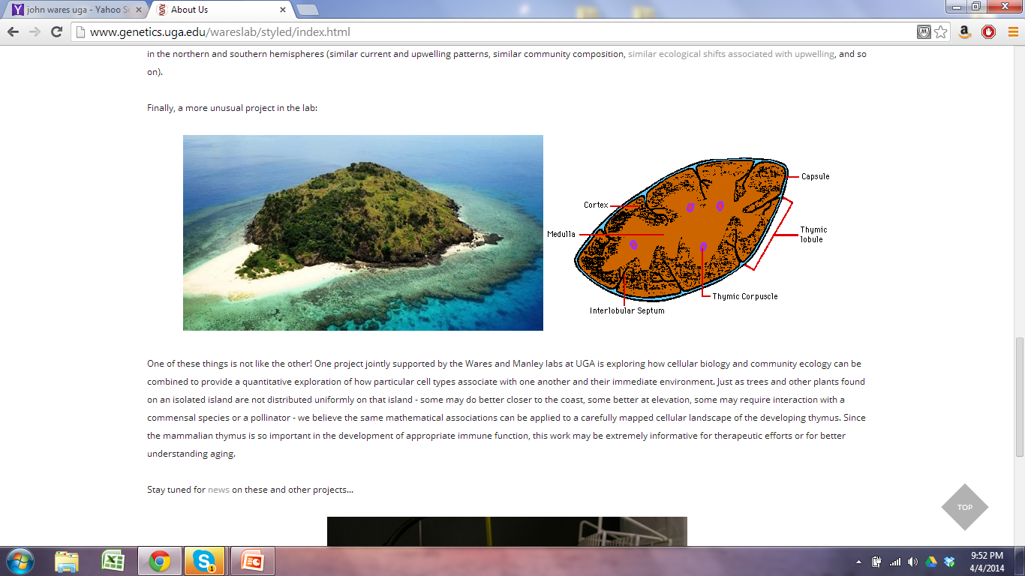
How can we quantitatively evaluate organization of cell types in organs?
Notes:
We came up with idea to treat organ like an ecosystem, can apply quantitative approaches used in ecology directly to a biological organ
For this project, we used the thymus for our analysis
for example: compare thymus to island:
different regions (island has sandy area where land that meets water, area dense with with trees, etc.
different compositions and abundances of SPECIES and CELLS that have different roles and distributions
By making this comparison and treating thymus like an ecosystem/ecological community, we can directly apply quantitative approaches to thymus
Thymus is great organ for this type of analysis/comparison. was chosen because because of structure and size.
Proper Cell organization is very impt for function.
Have cellular markers and markers for different t-cell differentiation stages.
Markers cover a good portion of the thymus so that we are able to create a thymic map of the cell types.
Through qualitative analysis (using cell specific markers), we know general patterns of regional organization
We don’t even know specifics about cellular organization.
Organs that would be especially useful for include:
endodermal glandular organs (thymus, liver, pancreas) , no discernable features
structure is more difficult to perceive (as opposed to organ like heart: cut open and see compartments and vessels)
organizational structures that are visible only with the use of molecular or cellular markers

Slide 4
Ecosystem | Organ
Do species aggregate or is distribution random? | Beyond regional organization, are cells in the thymus organized a certain way?
How is diversity distributed across the community? | Are patterns of organization consistent throughout the thymus? Throughout individuals? Random?
How does removal or addition of a species affect organization? | How does a wild-type organ differ from a mutant? Diseased organ?
Are there keystone species? | How does removal of a cell type affect organization?
Notes:
Several types of questions we want to ask with respect to organization
Keystone: removal will completely change organization of the system

Slide 5
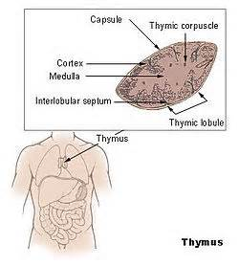

Background
Why is the thymus important?
Essential for proper immune system function
Programs T cells
Loss of functional thymic activity = reduced T cell output
Susceptibility to diseases
Autoimmunity
Notes:
Takes immature t cells and turns them into functional mature t cells (involved in immune response)
-involved in immune response
Lack of T cells-diseases
Autoimmunity-t cells that don’t function properly aren’t removed

Slide 6
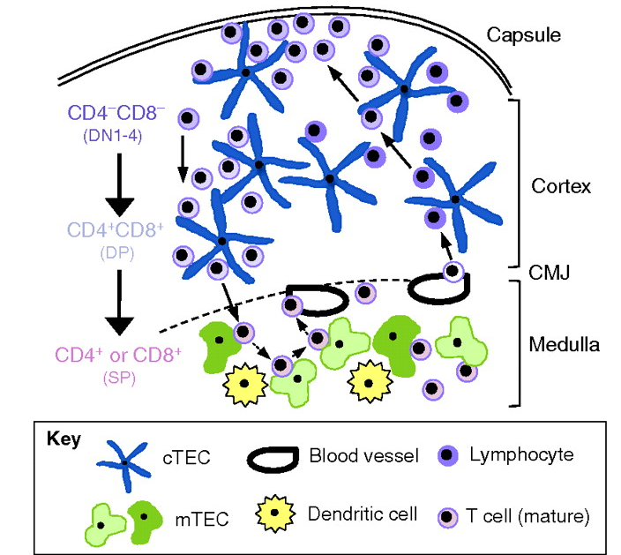
Thymus Cell Types and Migratory Pathway of T cells (Adult WT Thymus)
Notes:
Picture is showing section of thymus from the capsule downward to medulla
REGIONS-characterized by specific cell types
Several different regions
Cortex: Outer region
Medulla: Inner region
Cortocomedullary Junction (CMJ): Area where they meet
Subcapsular region: Outer cortex
Mesenchymal capsule that surrounds the thymus
CELL TYPES
Resident cell types:-make up the organ-stromal
Thymic epithelial cells (TECs)-support mTECs (medullary thymic epithelial cells)-cTEC (cortical thymic epithelial cells)
Vasculature-blood vessels
Dendritic cells-involved in maturation of t cells
Migrating cell types:
T cells
MIGRATION
Different things happening in different regions
Positive and Negative Selection
Cortex:
Thymocytes undergo positive selection to determine if they are functional, can detect peptide antigens-Self restricted
Medulla:
They undergo negative selection to remove overly sensitive, autoreactive thymocytes-self tolerant
Enter bloodstream to be taken out of thymus
At this point, they are naive, immunocompetent

Slide 7
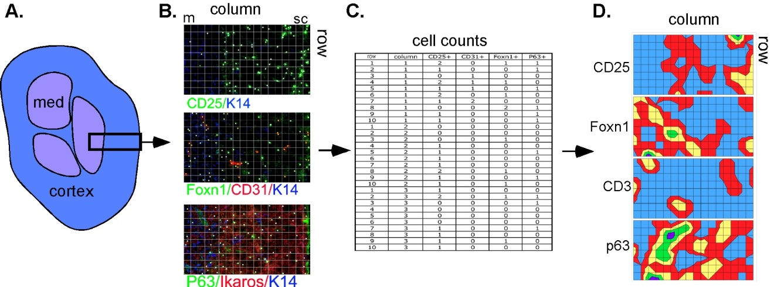
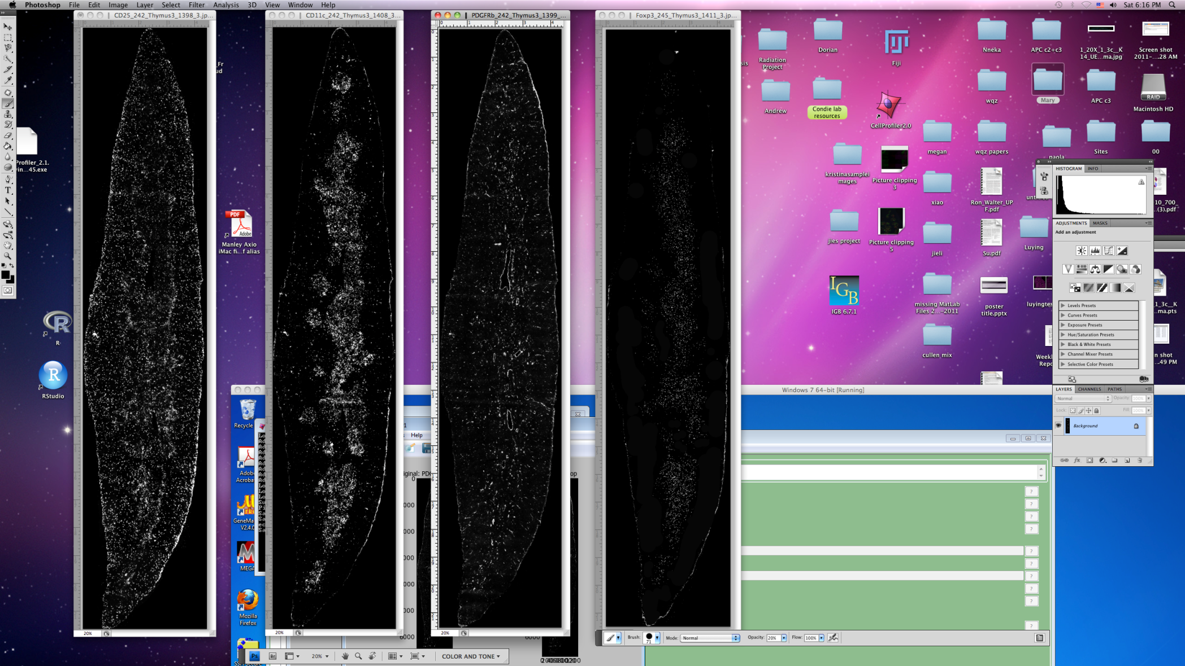
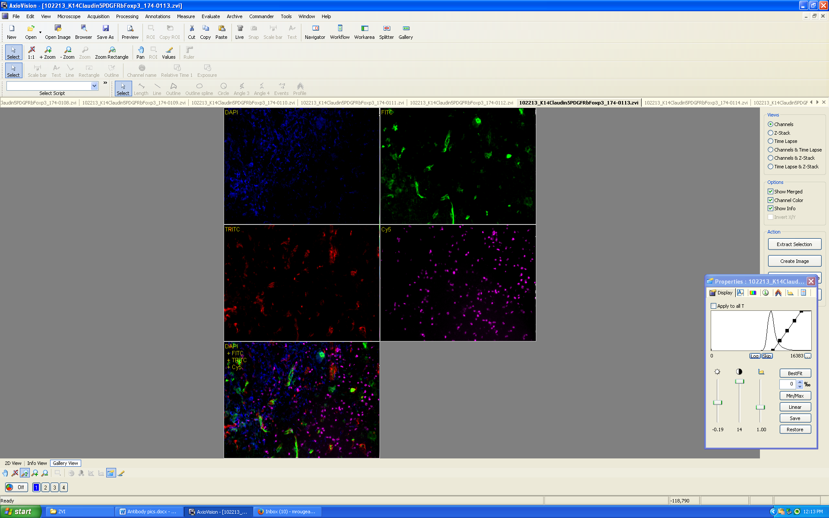
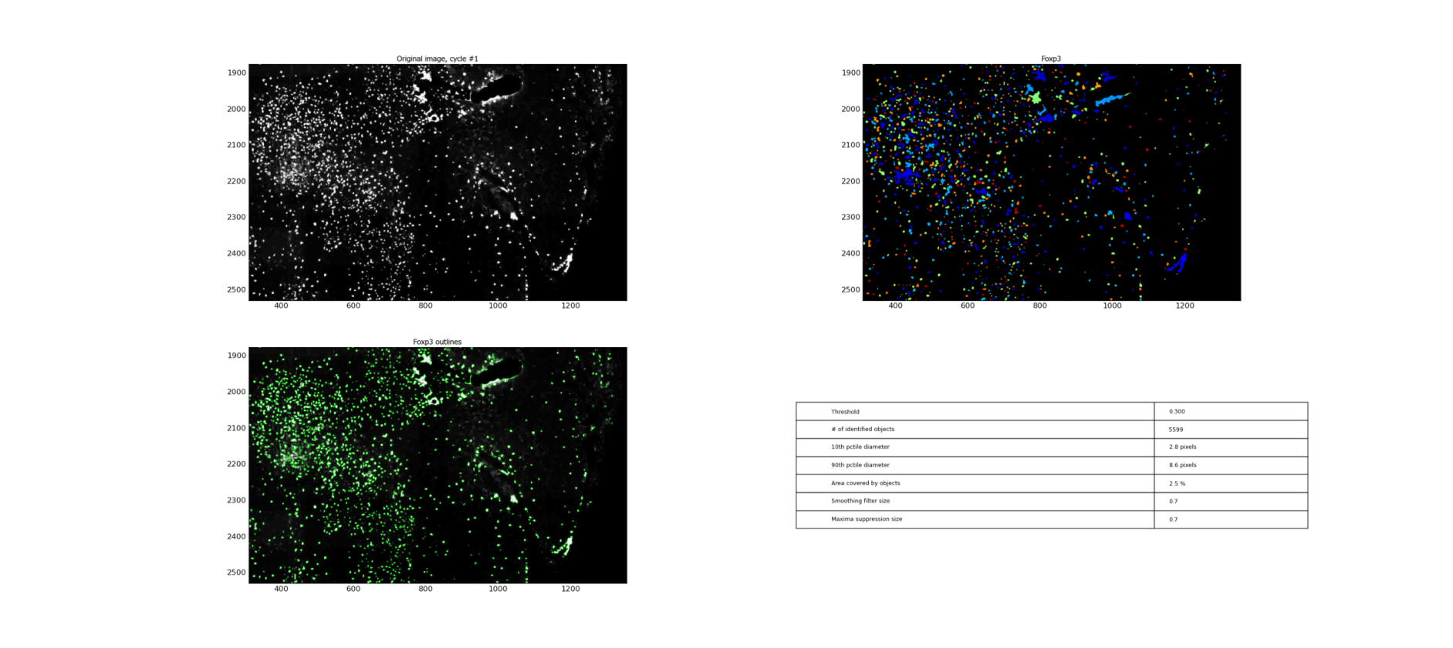

Overview of Methods-Identifying and analyzing cell types
Step 1 Step 2 Step 3 Step 4
Cut sections and
stain with antibodies
Take pictures
with microscope
Recreate section and
perform cell counts in CellProfiler
Perform spatial
analysis
Notes:
IDENTIFY MANY CELL TYPES (increased statistical power), do this with cell type specific antibodies
Take middle sagittal sections of 1 month old wild type left lobe thymus and stain them with antibodies that bind to specific cell types
Take pictures with microscope along the entire thymus section
Piece them together using PTGui (panaromic pic stitching software) and use Cell Profiler (cell counting program) to perform cell counts on sections
Use cell location and abundance info from these sections for spatial analysis, this image is showing a heat map of different cell markers
11 cell types
Example of 4 cell types on microscope
Limited by # of channels and antibodies available
Blood vessels,
Subsets of mTEC and cTEC
Subsets of T cells
Dendritic cells

Slide 8
Goal: Develop a quantitative model to characterize the spatial organization of cell types in a steady-state postnatal mouse thymus using cell location and abundance
Spatial and compositional clustering (K means)
Notes:
GOAL: develop quantiative model to characterize spatial organization of cell types in a WT mouse
First: Look at a WT mouse of same genotype and age
Determine if organizational patterns similar throughout individual thymus and bt WT thymii samples
If they are-develop a general model to characterize this organization
Determine this through the use of K means clustering

Slide 9
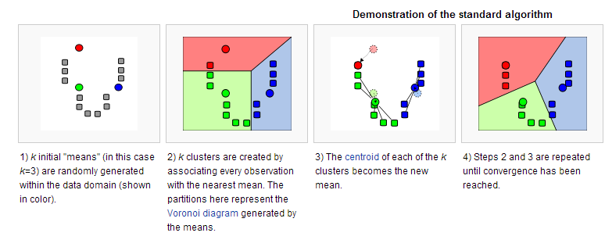
K means Clustering
http://en.wikipedia.org/wiki/K-means_clustering
Notes:
GENERAL overview of how Kmeans works
K-means clustering is a data mining technique that uses an algorithm to cluster observations with observations they are most similar to
The algorithm clusters observations into k groups, where k is provided as an input parameter.
GO OVER IMAGE
Minimize difference within a cluster and maximize difference between
WE CHOSE TO USE K MEANS AS OPPOSED TO OTHER CLUSTERING METHODS BECAUSE:
CAN CHOOSE DIFFERENT CLUSTER VALUES, identify cryptic info (manipulate K)

Slide 10

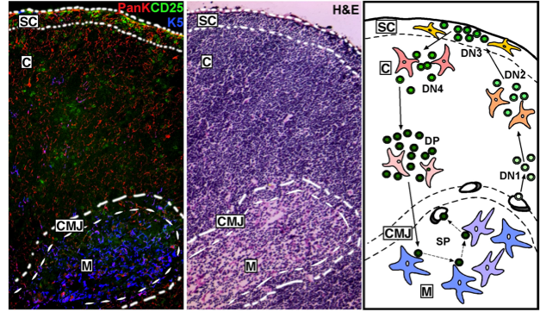
K means clustering
Regions
Cortex, Medulla, Subcapsular region, CMJ
Can these regions be computationally reproduced?
Do we identify cryptic information (other regions or subsets)?
Is pattern consistent throughout thymus? Between samples?
Notes:
Currently, descriptive methods used to describe the regional organization. –use antibodies, view them in microscope
Will allow us to test the structure of the thymus in a statistical framework (as opposed to descriptive)
Using cell location and abundance, computationally reproduce
We then used a range of K values to identify potentially cryptic organization.

Slide 11
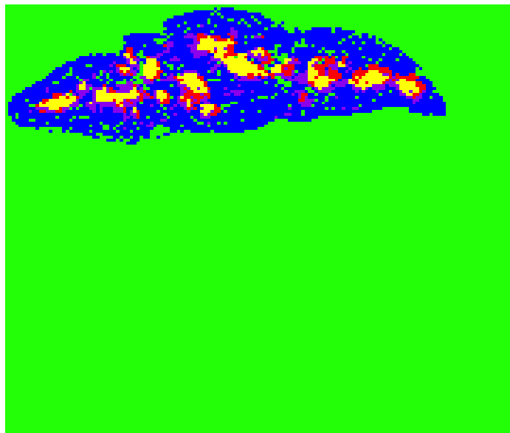
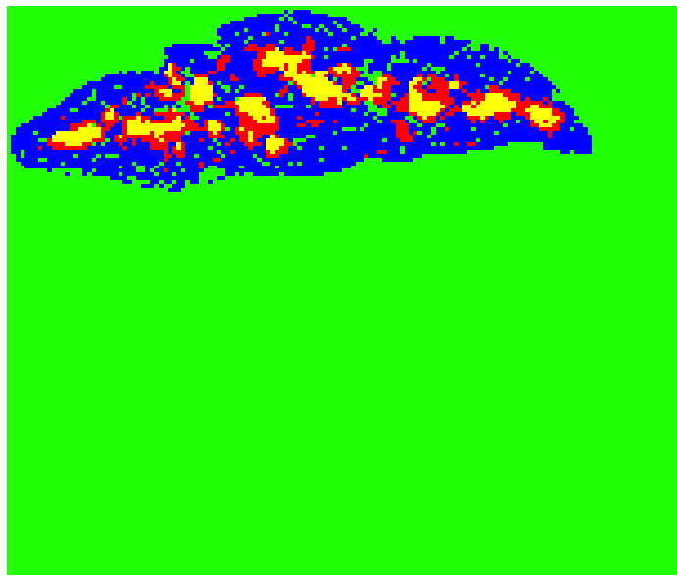
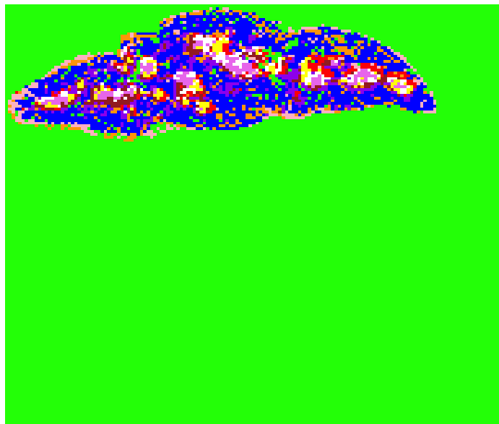
Results-Different Number of Clusters K=4 K=5 K=10
Notes:
Describe K and colors
Which K value are we interested in?
Too low? No valuable info
Too high? Are results real? Do we see useful info or random information
K=3 medulla and cortex; expected bc antibody and abundance bias
Don’t have antibodies specific for CMJ or Subcap
Increased to see if we would reproduce these regions or identify cryptic info (overlap of certain cell types).-clusters of cell types that have function
K=4 Subdivision of medulla, CMJ?
Proceed with develop methods, go back

Slide 12
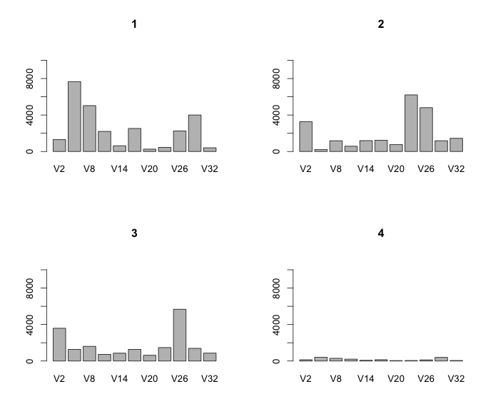
How is clustering being done?
Green Blue
Red Yellow
Notes:
Is it consistent bt samples?
Produced graphs showing the amount of each cell type per cluster.
Look at how cell types are clustering and what cell types could be driving this clustering

Slide 13
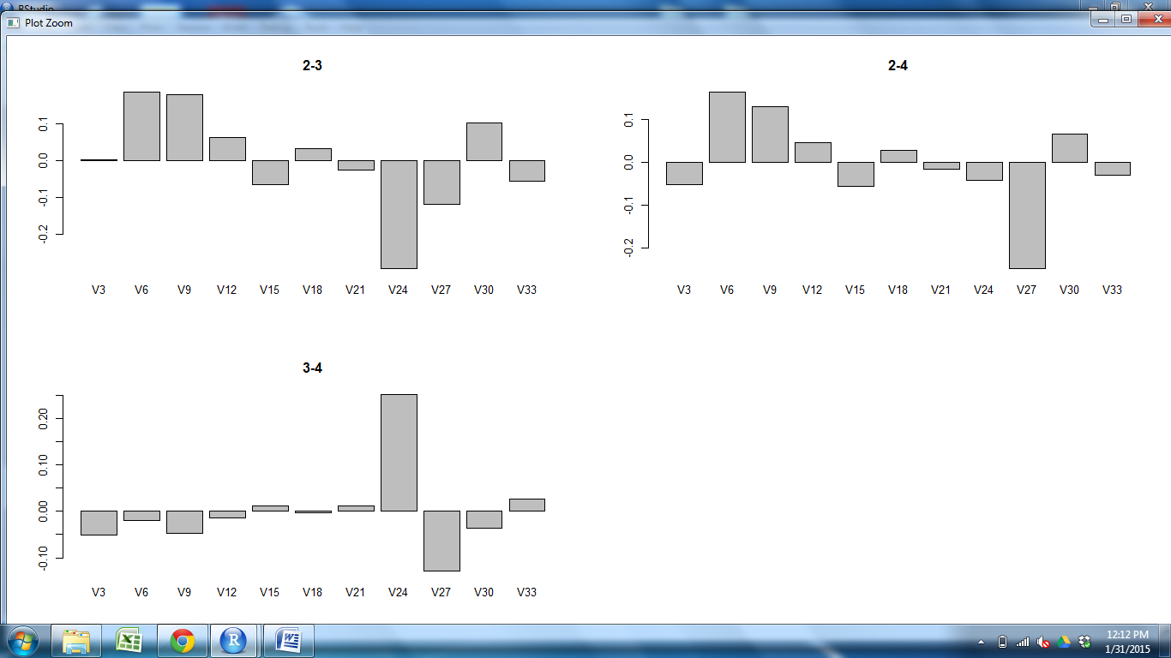
Comparing Clusters K=3
Yellow vs Red
Notes:
Comparison of cell types between clusters
Patterns similar between samples, still descriptive

Slide 14
Goal: Develop a quantitative model to characterize the spatial organization of cell types in a steady-state postnatal mouse thymus.
Spatial and compositional clustering (K means)
Use an ecological index on different regions that are produced
Notes:
Provides Useful compositional and geographical information, but Graphs Quantitative value; not descriptive.
Begin to apply ecological methods to the thymus
In ecology, dissimilarity indicies can compare the identity and relative abundance of species across communities to determine degree of dissimilarity
The Bray Curtis Dissimilarity Index in particular is a well characterized statistical method that looks at composition between sites
Value between 0 and 1,
0 = identical, 1=don’t share any species
Use this index to determine how similar clusters produced from K means as well as other samples.
make comparisons with sections in same thymus and between thymuses
amount of distinctiveness can also be compared to ecosystems/natural systems/ecological communities for non organ biologists

Slide 15
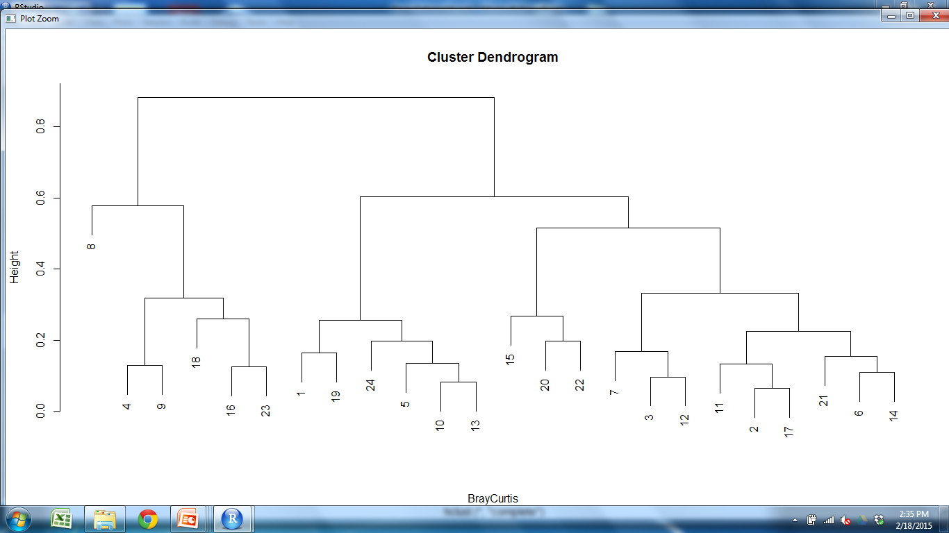
Bray Curtis Dendrogram
OUTER CORTEX MEDULLA1 MEDULLA2
Key
WT1=
WT2=
M2S3 M2
Notes:
BC produced results from 0-1; Produced dendrogram using BC results
There is small variability between sections (don’t expect them to be identical)
Regions are grouping together, aren’t just grouping with sample they came from
Some of One sample are grouping more closely with M2 than M1, NEED LARGER SAMPLE SIZE
Based on these results, different samples are compositionally similar.

Slide 16
Goal: Develop a quantitative model to characterize the spatial organization of cell types in a steady-state postnatal mouse thymus.
Spatial and compositional clustering (K means)
Use an ecological index on different regions that are produced
Repeat with Mutant
Notes:
Test model with a mutant
Can we detect any organizational differences bt WT and mutant?

Slide 17
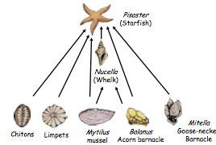
Removal of a “Species”
Keystone species
Notes:
We used a mutant knockout; Removed one of the cell types (subset) whose phenotype has been characterized; functionally important based on phenotype
Organization difference?
Keystone species=removal completely alters organization of community
Regular species =still important but doesn’t produce any noticable organizational effects
Aire = TF expressed in subset of mTECs
Removal causes defective negative selection and multi-organ autoimmunity
Defects in organization or composition?

Slide 18
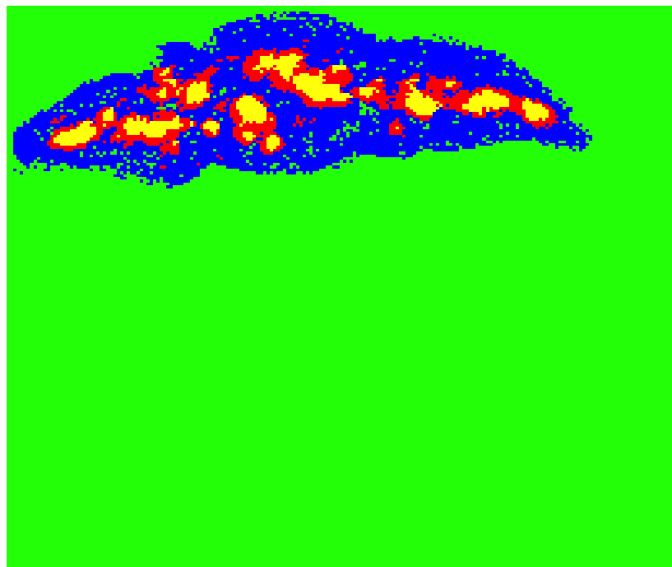
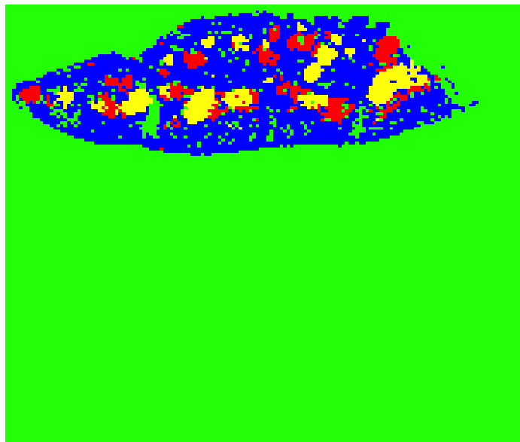
Notes:
Different organization? Organization of clusters not as consistent
Will have to test with replicates

Slide 19
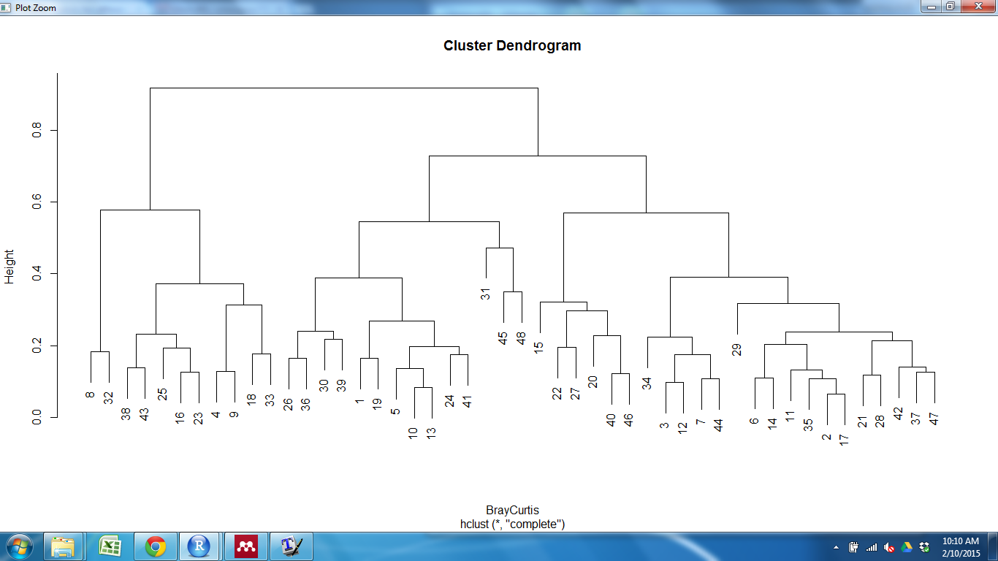
Bray Curtis Dissimilarity Index
OUTER CORTEX MEDULLA1 MEDULLA2
Key
WT1= Mutant1=
WT2= Mutant2=
PICTURESKSDLD
Notes:
Produced dendrogram.
Based on these results, different samples are compositionally similar. What about spatially with respect to clusters?

Slide 20
Goal: Develop a quantitative model to characterize the spatial organization of cell types in a steady-state postnatal mouse thymus.
Spatial and compositional clustering (K means)
Repeat with mutant
Use an ecological index on different regions that are produced
Look at spatial relationships between cells

Slide 21
Notes:
Manually find centroid;
WT=centroid in center; small distance between: M2 is inset in M1
Mutant-adjacent, further distance between ; offset from

Slide 22
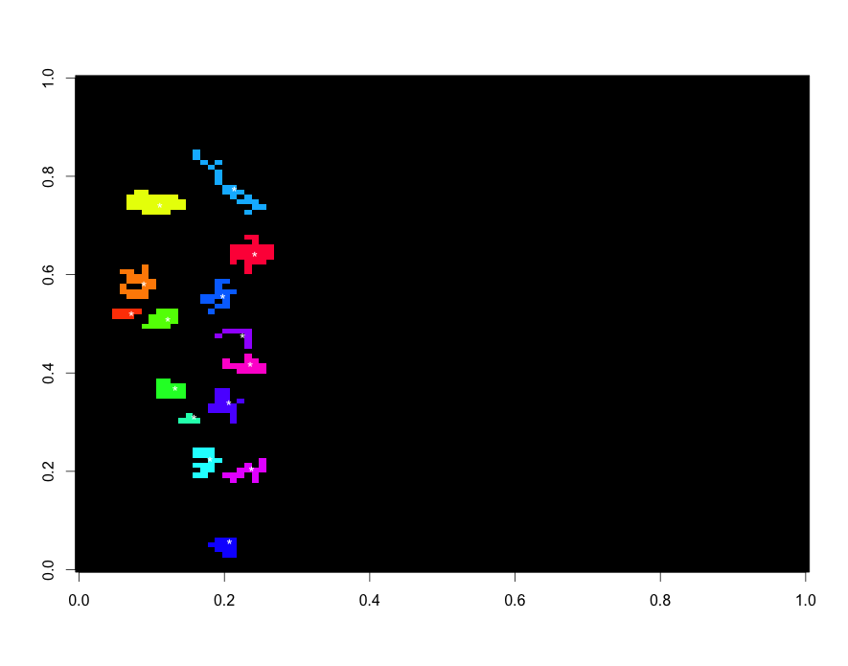
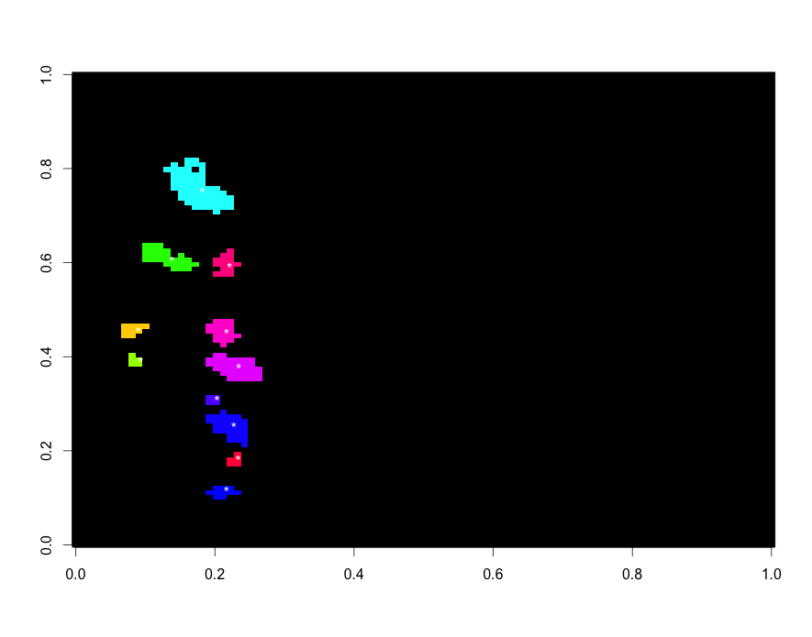
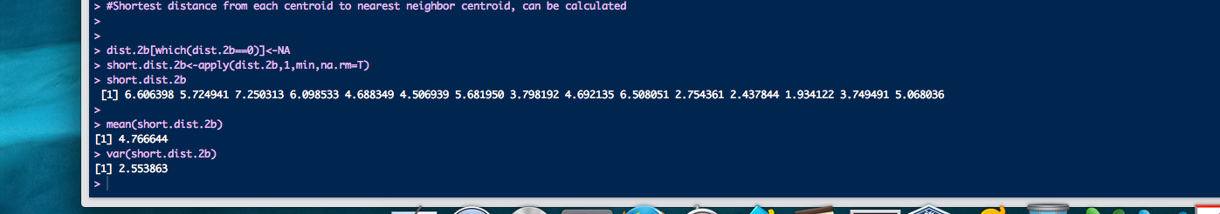

Slide 23
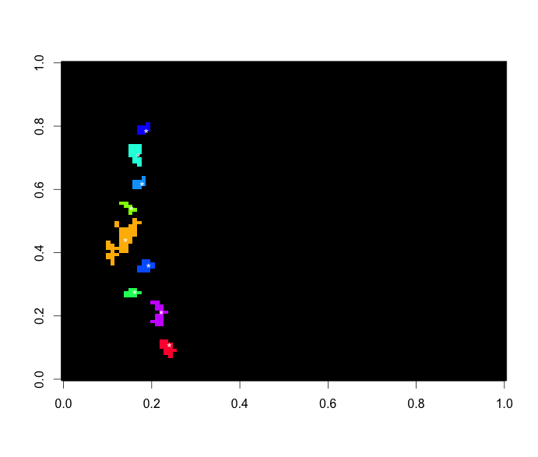
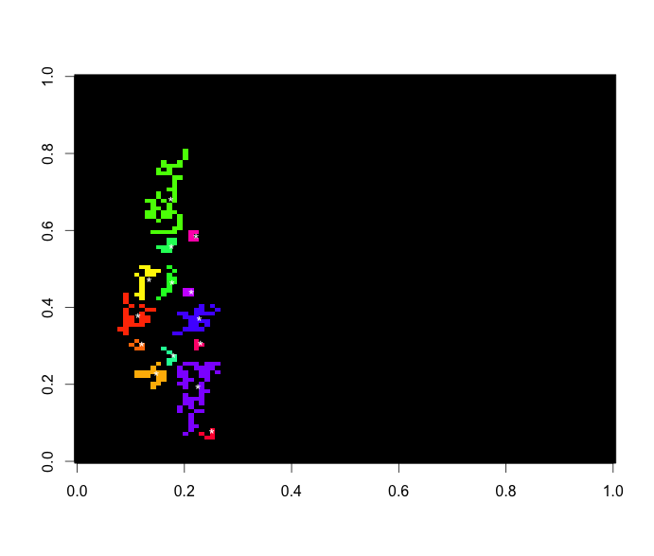
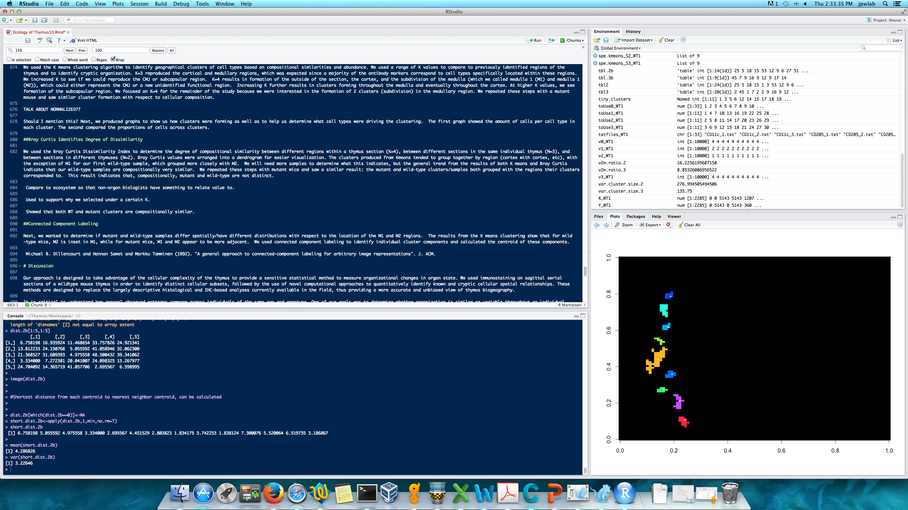

Slide 24
CCL
 | Mean | Variance
WT1_150 S1 | 3.95 | 4.61
S2 | 4.03 | 3.52
S3 | 3.35 | 2.05
WT2_150 S1 | 7.84 | 21.52
S2 | 4.69 | 5.60
S3 | 9.67 | 48.74
Mutant1_150 S1 | 5.84 | 3.73
S3 | 3.46 | 1.35
Mutant2_150 S1 | 11.71 | 60.7
S2 | 11.67 | 58
S3 | 9.014 | 50.84

Slide 25
Conclusions and Future Directions
We have developed a method to quantitatively evaluate the thymus
Further Analysis
Increase sample size
Manipulate K value
Test different mutant/involuted thymus
Try different ecological measures
Removal of cell types from analysis

Slide 26
Acknowledgements
Committee:
John Wares
Nancy Manley
Andrew Park
Brian Condie
Lab Members
Manley Lab
Wares Lab
Dr. Jena Chojnowski
Notes:
INCLUDE RAREFACTION CURVE

Slide 28
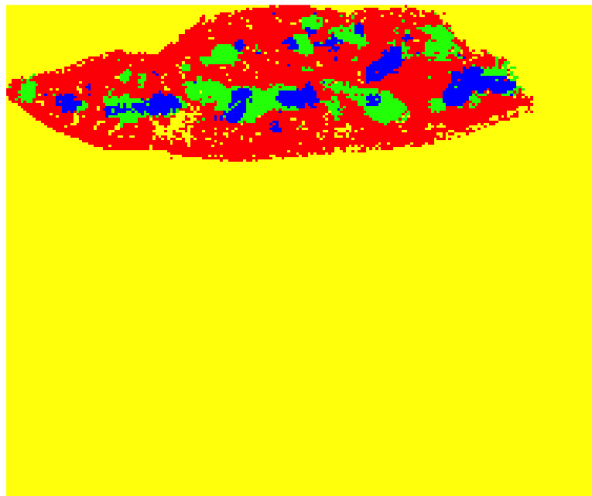
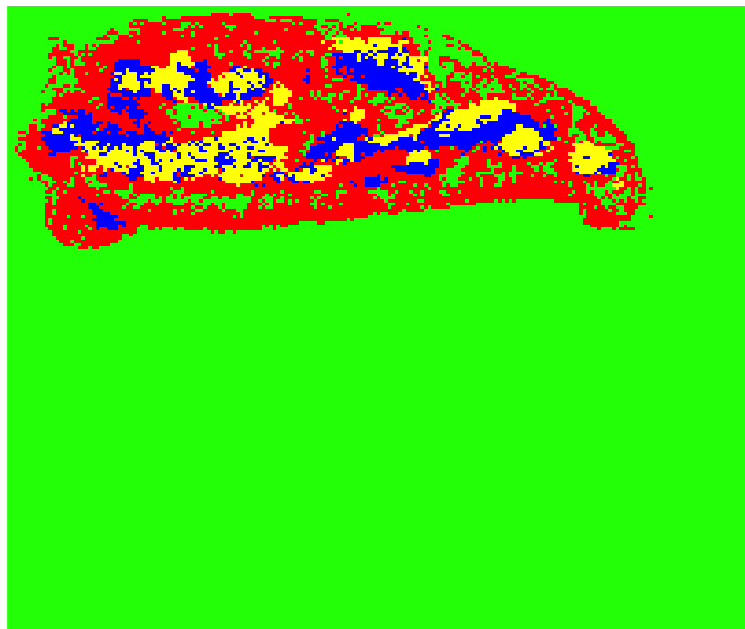
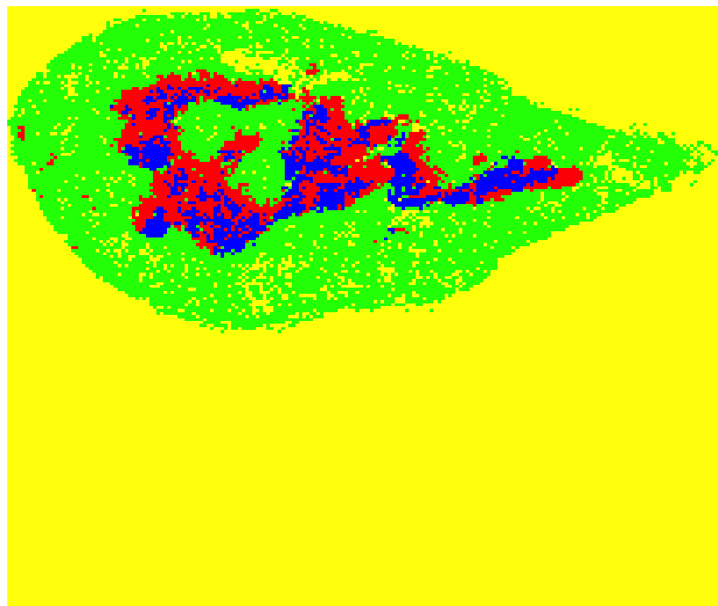
Thymus 1 K means clustering WT vs Mutant K=4 All sections (9)

Slide 29
Virtual Sections
Antibody Set 1
Antibody Set 2
Antibody Set 3
Virtual section
Collapse 3 virtual sections= virtual slice

Slide 30
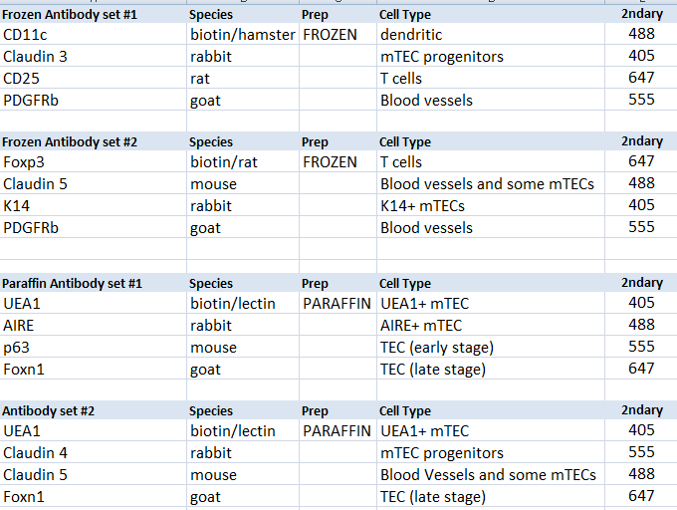
Combinations of Antibodies Finalized List-Frozen and Paraffin 7 cell types
Notes:
Cross reaction if 2 of same species in same set
CD11c-dendritic cells (antigen presenting) and some activated t cells, Central tolerance of T cells, b cells and NK cells (apoptosis of self reactive t cells), cellular adhesion
Claudin3&4- membrane protein, tight junction family, cell to cell adhesion in epithelial/endothelial sheets, for seals around cells, physical barrier to solutes and water, PREFERENTIALLY EXPRESSED IN aire+ mTECS, CLDN3,4, UEA1 tecs represent initial progenitors specified for Aire+ mTECS
CD25-glycoprotein, expressed on activated T and B cells, thymocyte subsets, pre-b cells, and t reg cells, IL2 receptor, transmembran protein present on activated T cells, DN2 and DN3 are CD25+ ; DN1-DN4 – CD4 CD8 SP
PDGFRb-Perivascular cells express mesenchymal markers, so does capsule
Gene encodes a cell surface tyrosine kinase receptor, binding causes phosphorylation (may control growth, division, movement, survival, development)
Foxp3-forkhead box p3, transcriptional regulator, high expression in CD4CD25 reg t cells, suppress immune response of other cells “self check” to prevent excessive reactions and prevent self reactivity, occurs in medulla, some t cells become Treg and rest leave thymus
Claudin5-cell surface/transmembrane marker, claudin family, tight junction strands of endothelia and epithelia tissues
K14-keratin, cytoplasmic intermediate filament protein, expressed in epithelial tissues, provide mechanical support, maintain cell shape
UEA1-lectin (binds carbohydrate), endothelial cell marker, binds K8 and not K14,K5, AIRE more preferentially expressed in this subset, suggests these cells represent more advanced stage of mTEC differentiation
AIRE-autoimmune regulator, transcription factory that is highly expressed in perinuclear region of mature medullary thymic epithelial cells, central tolerance, controls transcription of many genes encoding highly diverse, tissue-restricted self antigens, in absence of AIRE, mTECS fail to delete thymocytes expressing Tcell “self” receptors
P63-related to tumor suppressor gene family, early epithelial cell marker, induces expression of differential markers and shortly after its own levels are reduced, may stimulate cell survival
Foxn1-member of forkhead transcription factor family, generates mature thymic epithelial cells from immature progenitory, requires through development to maturity, “master regulatory” in TEC lineage specification, tec patterning in fetal stage and tec homeostasis in postnatal thymus

Slide 31
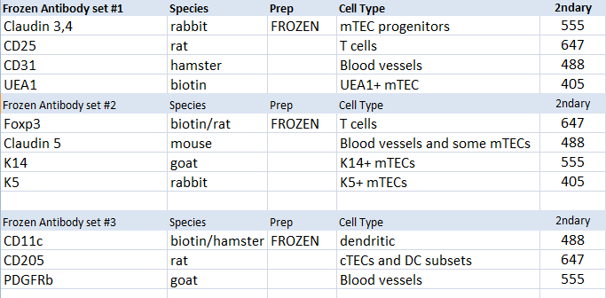
Combinations of Antibodies Finalized List-Frozen 11 cell types

Slide 32
Size conversion (from pixels to mm)
Original pixel size/4 = ~1500 pixels width
6695 pixels =8.5mm
788 pixels/mm
6462 pixels = 8mm
810pixels/mm
5635=7mm
805 pixels/mm
Notes:
CellProfiler uses pixel information, outputs info in pixels
Pixels not biologically meaningful, change to mm (1000 microns) or microns

Slide 33
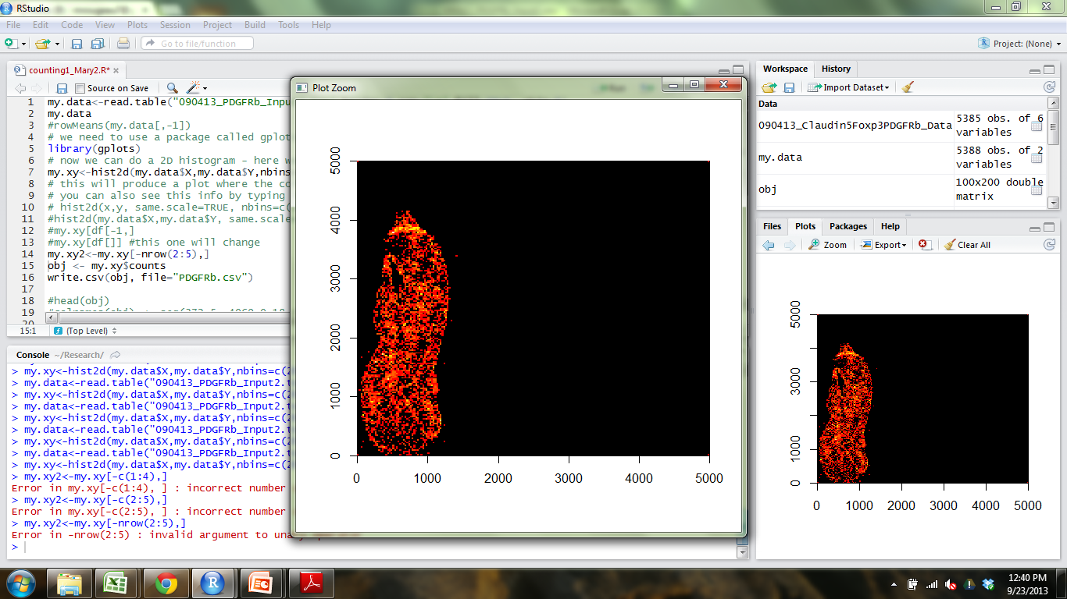
R
Notes:
CellProfiler outputs X and Y coordinates of cells
2dHistogram function to bin coordinates into quadrants of size that I choose-200x200 boxes, 100x100-
want to look like community matrix, with bins that has count info
Since I am looking at multiple sections, I want bin sizes to be the same between sections
I add 4 points (0 and point larger than section height)-6000 for thymus1
(0,0) ,(0,6000),(6000,0),(6000,6000) (I wanted them to be square)
2dhisto-Matrix (grid) is built that holds the counts that fall into each bin/quadrant of grid
Use the counts in the quadrants for analysis

Slide 34
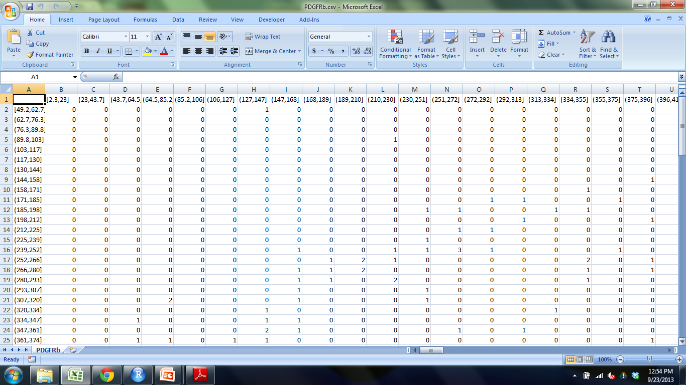
Output from 2D histogram
Notes:
Cell counts in each bin/quadrant
Bin sizes are in pixels, convert to mm or microns

Slide 35
Standard Real Measurement of bin sizes
5635 = 7 mm
5635/7 = 6000/x x=height of 6000x6000 box in mm
X= 7.453 mm
Assuming 200x200 bins
7.453/200 = 0.037265mm = 37.2 x 37.2 microns

Slide 36
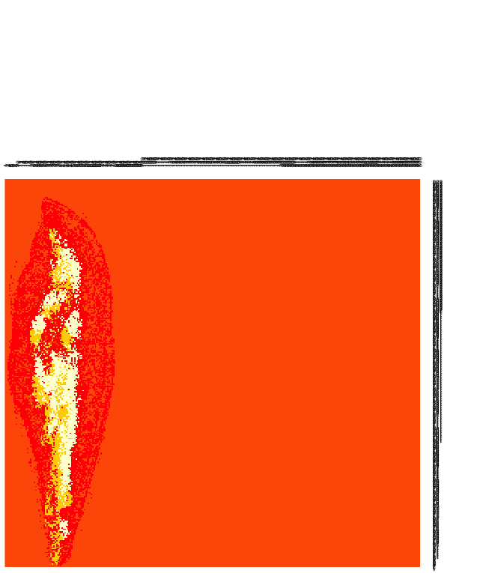
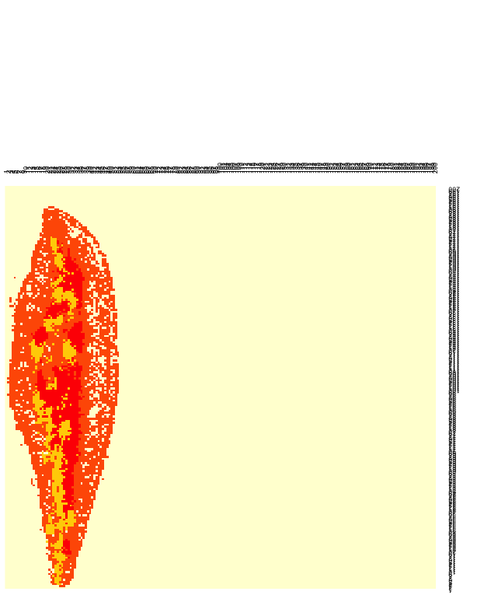
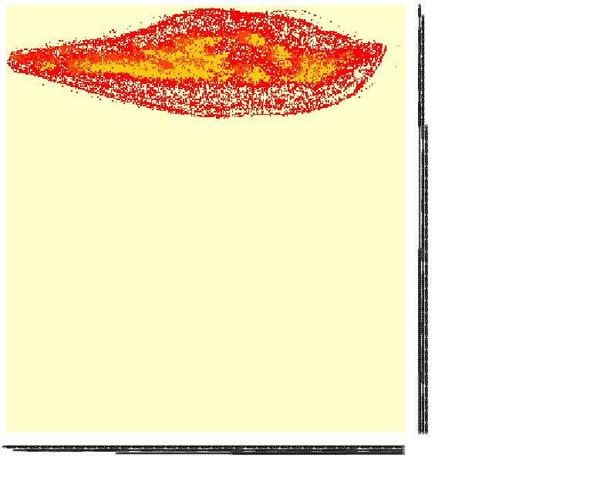
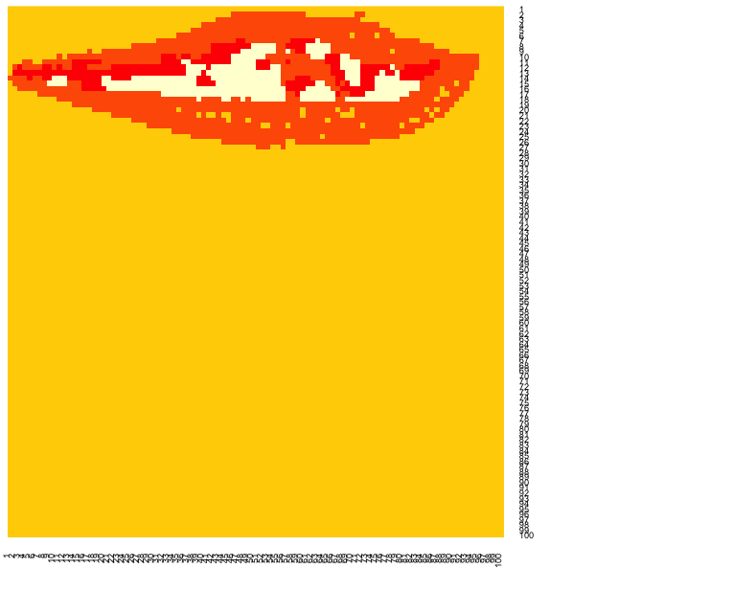
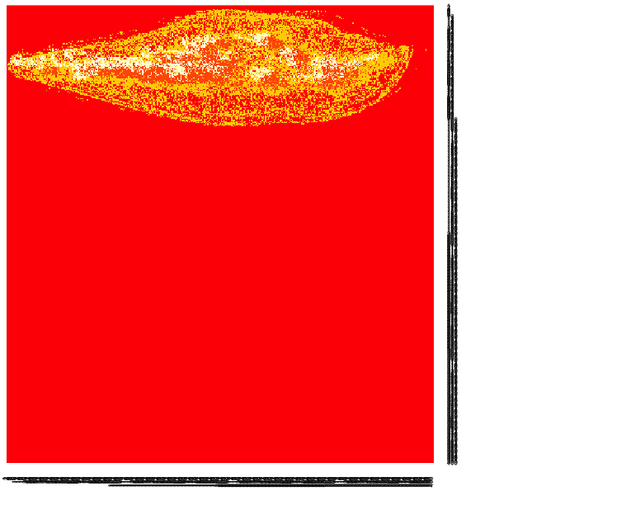
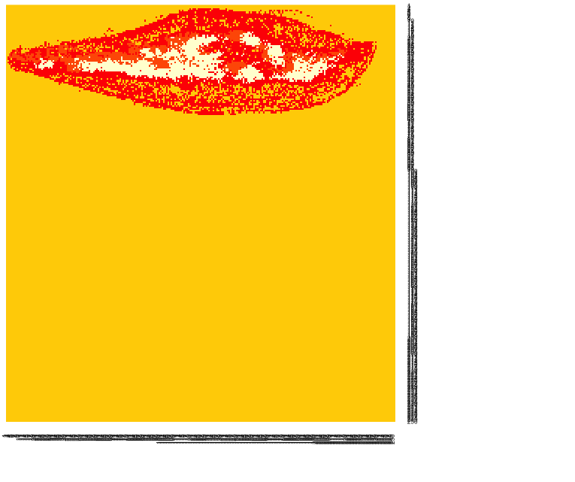
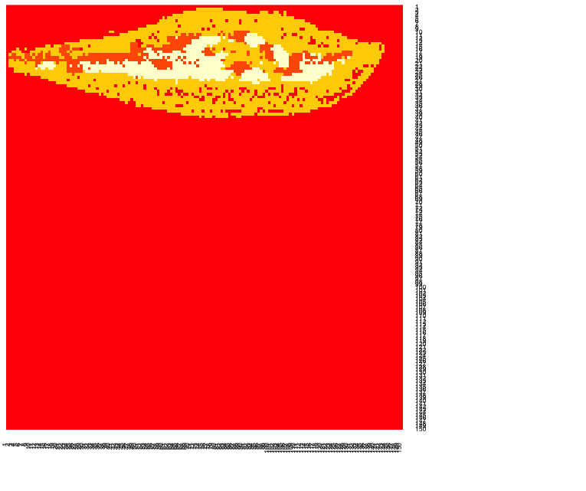
Different bin sizes (K=4)
400x400 350x350 300x300 250x250 200x200 150x150 100x100
Which bin size is optimal?
Notes:
First time I did analysis, I Randomly picked 200x200, cell counts in each bin were reasonable number (not too high or low)
Not good reason, Need something to support this number

Slide 37
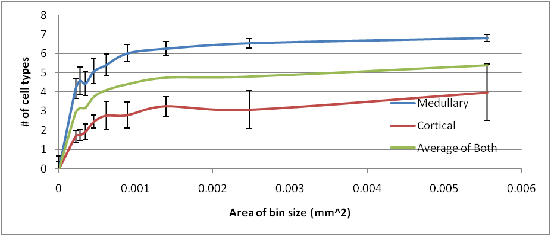
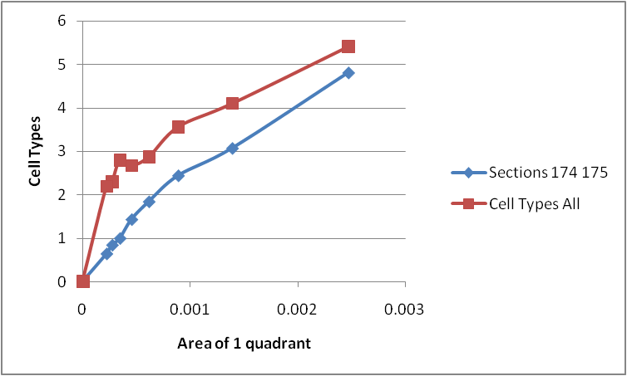
Rarefaction Curve
Area (mm2) | BINS
0.00022 | 500x500
0.00027 | 450x450
0.00035 | 400x400
0.00045 | 350x350
0.00062 | 300x300
0.00089 | 250x250
0.00139 | 200x200
0.00247 | 150x150
0.00555 | 100x100
0.0222 | 50x50
Notes:
Determining the optimal quadrant size: Rarefaction
Rarefaction-technique used in ecology to assess species richness (# of species) from the results of sampling.
The issue that occurs when sampling species in a community is that the larger the number of samples, the more species that will be found.
When have you collected enough samples? (when is the bin size small/large enough) large bin size=more samples, get to point where you will lose info
Want to find the smallest unit of area that still contains useful information, construction of rarefaction curves,
Selected 5x5 quadrants and took average over a section of thymus that contained #of cell types (as opposed to # of cells). I did this 8 times in cortex and 8 times in medulla (since medulla had higher cell counts than cortex) and took average of that
Steep slope indicates that a large fraction of the species diversity (cell types) remains to be discovered.
When the curve becomes flatter to the right, a reasonable number of individual samples have been taken: more sampling is likely to yield only few additional species.
Saturated for medullary region when curve plateaus, probably won’t have all 7 cell types in the cortex (medullary markers)

Slide 38

Community Matrix
Notes:
Take the count information from 2Dhistogram and Reformat into community matrix with some species (columns) and where they are located (rows).
Initially had location information (way of identifying bin locations) but this info took over the clustering
This is the format I will use for my analysis (kmeans)

Slide 39
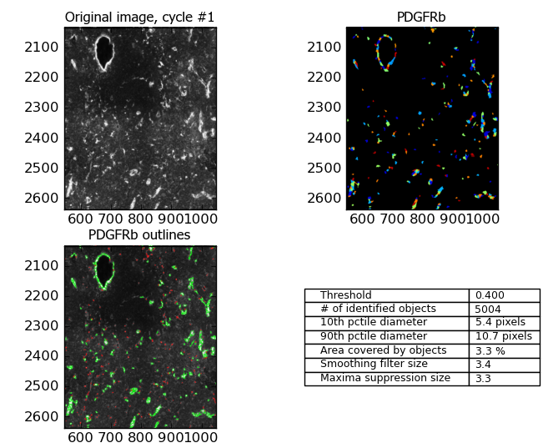
CellProfiler Results-Blood vessel marker
CD25
Notes:
Input images from Ptgui into Cellprofiler to get cell counts which will be used for analysis
Real signal, Intensity of fluorescence
Different colors = different cells,
Finds centroid of cell and outputs x and y location
This shows a zoomed in portion of the thymus so you can see what CP considers to be a cell
Green is what CP detects bc of parameters I set, centroid!
Take cellprofiler results, reformat, use them in R
Place grid over thymus section and record # of cell for each cell type that fall into each box of the grid

Slide 40
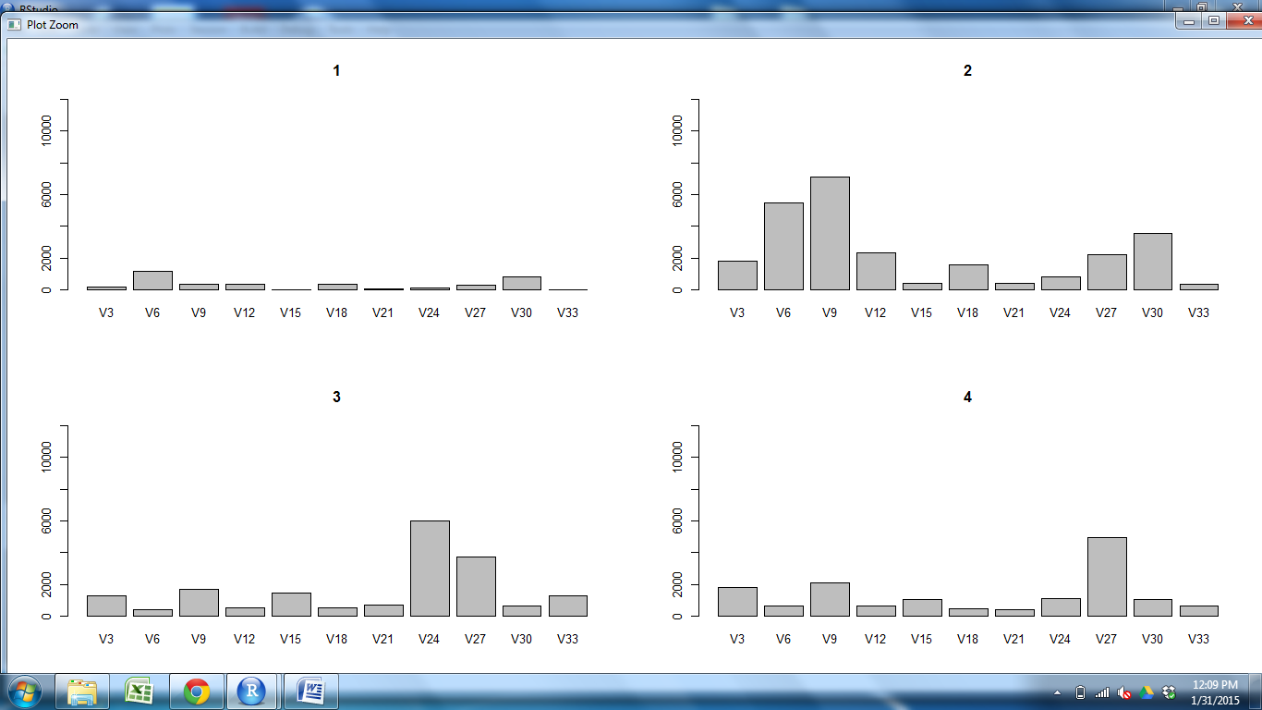
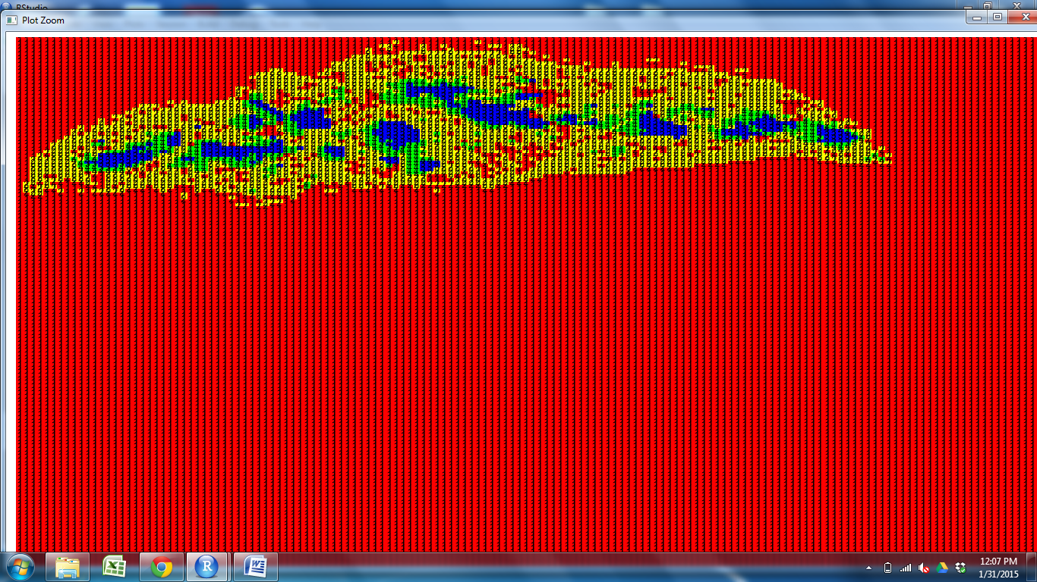
How is clustering being done?
Red Yellow
Blue Green
CD11c CD25 CD31 CD205 Claud5 Claud34 Foxp3 K5 K14 PDGFRb UEA1
Notes:
Is it consistent bt samples?
Produced graphs showing the amount of cell type per cluster.
Look at how cell types are clustering and what cell types could be driving this clustering

Slide 41
Bray Curtis
OUTER CORTEX MEDULLA1 MEDULLA2
WT1S2 O
WT2S2 O
WT2S1 M1
WT2S3 C
WT2S2 M1
WT1S1 C
WT2S3 M1
WT2S2 C
WT1S2 C
WT1S2 M1
WT2S3 M2
WT1S1 O
WT1S3 O
WT2S3 O
WT1S3 M2
WT2S1 O
WT1S1 M1
WT1S3 M1
WT2S1 M2
WT1S3 C
WT2S1 C
WT1S1 M2
WT1S2 M2
M2S3 M2
WT2S2 M2
Notes:
Produced dendrogram using BC results
There is small variability between sections (don’t expect them to be identical)
Regions are grouping together, aren’t just grouping with sample they came from
Based on these results, different samples are compositionally similar.

Slide 42
Bray Curtis Dendrogram
OUTER CORTEX MEDULLA1 MEDULLA2
Key
WT1=
WT2=
WT1S2 O
WT2S2 O
WT2S1 M1
WT2S3 C
WT2S2 M1
WT1S1 C
WT2S3 M1
WT2S2 C
WT1S2 C
WT1S2 M1
WT2S3 M2
WT1S1 O
WT1S3 O
WT2S3 O
WT1S3 M2
WT2S1 O
WT1S1 M1
WT1S3 M1
WT2S1 M2
WT1S3 C
WT2S1 C
WT1S1 M2
WT1S2 M2
M2S3 M2
WT2S2 M2
Notes:
Produced dendrogram using BC results
There is small variability between sections (don’t expect them to be identical)
Regions are grouping together, aren’t just grouping with sample they came from
Some of One sample are grouping more closely with M2 than M1, NEED LARGER SAMPLE SIZE
Based on these results, different samples are compositionally similar.

Slide 43
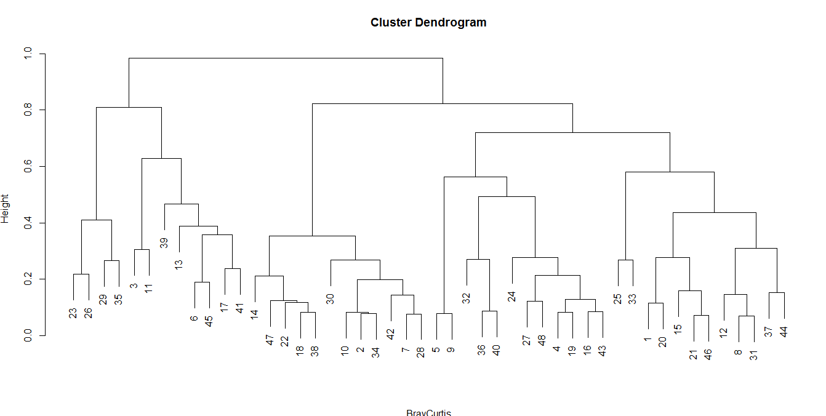
NORMALIZED
OUTER MEDULLA SUBCAPSULE CORTEX
M2S1 O
WT2S1 O
WT1S1 O
M1S3 O
WT1S3 O
M1S2 S
M1S2 O
M1S2 M
WT2S3 S
M1S1 C
M2S2 O
M1S3 C
M1S1 O
WT2S2 O
WT2S3 O
WT1S2 O
WT2S1 M
M2S3 O
WT2S1 C
M2S1 C
M2S3 M
M2S2 M
M1S1 S
WT1S3 C
M2S2 C
WT2S3 M
WT1S3 S
M2S3 S
WT1S1 S
WT2S2 M
WT1S1 M
WT1S2 M
M1S3 S
WT1S1 C
WT2S2 C
M2S1 M
M1S3 M
WT1S2 S
M2S1 S
M2S2 S
WT1S3 M
M1S1 M
WT2S2 S
WT2S1 S
WT2S3 C
WT1S2 C
M2S3 C
M1S2 C

Slide 44
Bray Curtis Dissimilarity Index
OUTER CORTEX MEDULLA1 MEDULLA2
Key
WT1= Mutant1=
WT2= Mutant2=
M1S2 C
M2S3 O
M2S3 C
WT2S1 M1
M1S2 M2
M1S1 O
M2S1 C
WT2S2 M1
M1S3 M1
M1S2 O
M1S3 O
M1S2 M1
M1S1 M1
WT1S2 O
M1S1C
WT2S3 C
WT2S2 O
M1S3 C
WT1S1 C
M2S2 O
WT2S2 C
M2S2 C
WT2S3 M1
M2S1 O
WT1S1 O
WT1S3 O
WT2S3 O
WT1S2 C
WT2S1 O
M2S1 M1
WT1S2 M1
WT1S2 M2
M2S1 M2
M2S3 M1
WT1S1 M1
M2S2 M1
WT2S1 M2
WT1S3 M2
M2S2 M2
WT2S1 C
WT1S3 M1
M1S3 M2
WT2S3 M2
M2S3 M2
WT1S3 C
WT1S1 M2
M1S1 M2
WT2S2 M2
Notes:
Produced dendrogram.
Based on these results, different samples are compositionally similar. What about spatially?

Slide 45
Mutant-Aire knockout
Aire = TF expressed in subset of mTECs
Removal causes defective negative selection and multi-organ autoimmunity
Defects in organization or composition?
Phenotype: Viable, normal in size, and at birth don’t display physical/behavorial abnormalities. Females infertile. mTEC number is doubled. Possible displaced dendritic cells
Anderson MS et al. 2002. Projection of an immunological self shadow within the thymus by the aire protein. Science 298(5597):1395-401-Dendritic phenotype similar between WT and Mutant
Notes:
Keystone species, where removal affects organization,
Could have no organizational differences but still be very functionally impt.
EXAMPLE???
Negative selection-removal of tcells that recognize self antigens and attack the body
Model as Regulator of tissue restricted antigens or as key modulator of mTEC differentiation
-Relative species abundnance may not be affect or may change dramatically
-Look at UEA1
A loss or reduction in expression occurs for a substantial number of genes in MECs, an observation consistent with the targeted gene's role as a transcriptional activator.
Conflicting conclusions

Slide 46
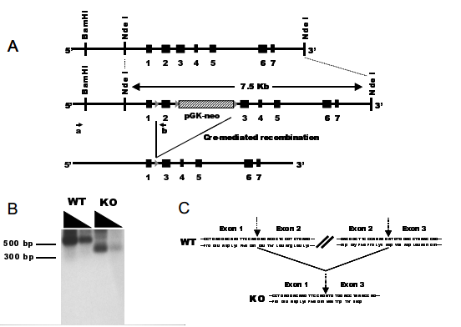
Aire Mutant
Anderson et al,
Notes:
Development To create this mutant, the originating investigator employed a targeting vector bearing a loxP site-flanked Pgk-neo cassette inserted into intron 2. An additional single loxP site was placed in intron 1. The targeting construct was electroporated into 129S2/SvPas-derived D3 embryonic stem (ES) cells. Correctly targeted ES cells were injected into C57BL/6 blastocysts. The resulting chimeric mice were mated with CMV-cre transgenic mice on a C57BL/6 background. Exon 2 and portions of introns 1 and 3 were excised in the offspring. The resulting chimeric animals were crossed to C57BL/6 mice. Heterozygous offspring were crossed to
We engineered a line of mice carrying a defective aire gene by means of lox/cre-mediated recombination in embryonic stem (ES) cells (fig. S1). These mice carry in homozygous state a mutant allele bearing a deletion of exon 2 and portions of the upstream and downstream introns (fig. S1A). Mature aire gene transcripts could be detected at nearnormal levels in the thymus of mutant mice, but these were smaller than in the wild type, as expected given the absence of exon 2 (fig. S1B). Sequence analysis confirmed that these transcripts could not give rise to functional protein because a frame shift provoked by the abnormal juxtaposition of exons 1 and 3 resulted in premature truncation shortly after exon 1 (fig. S1C). The aire gene mutation was generated in ES cells derived from mice of the Sv/129 strain, and mice used in the experiments described here were from F[sub2] or F[sub3] backcrosses onto the B6 genetic background.

Slide 47
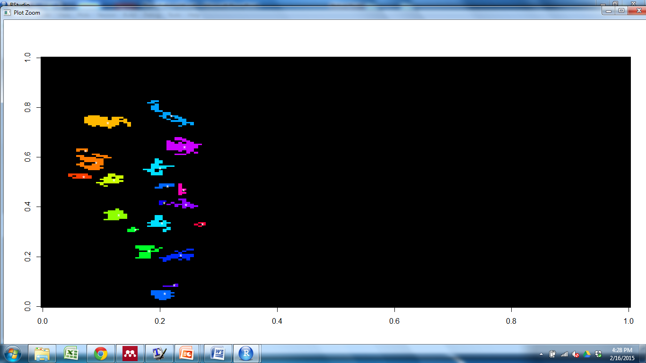


Connected Component Labeling-Mutant1
Notes:
Look at spatial distribution of clusters as opposed to composition
Looks at components that are connected; find centroid, compare to centroid in other cluster

Slide 48



Connected Component Labeling-WT1

